Slide 1
GEOG0113 Measurement Guidance
H.Heorton
UCL Geography
& NERC NCEO

Slide 2
Disturbance (Fire)
How is this topic covered using remote sensing methods?
What enables burning and burnt land cover to be observed remotely?
What operational data products are available for monitoring, and how do they relate to the previous point?
Are there any remarkable recent results from these observations?
What emissions from fires are important in a global context?
As a contributor to carbon fluxes, as a pollutant?
What emission data are available and how are they created?
How are fires represented in modelling studies?
Fire specific models
As part of global climate models
How are observations used alongside models?

Slide 3
Carbon Stocks
Biomass density from ground data and allometric relationships
How can BIOMASS be measured?
What measurements exist at different scales?
Is there a particular location that will make for a good case study?
Ground-based measurements of leaf area
How can this be achieved? What are the different techniques?
How are ground based measurements scaled up to satellite maps?
Biomass density from remote sensing
What satellite instruments can be used for estimates of above ground biomass?
How do these work, and what are the limitations?

Slide 4
Carbon Fluxes
Carbon fluxes: Flux tower measurements
What is a flux tower, and how does it work?
What are the limitations for this method, and how are these dealt with?
What key values can we get from these measurements?
Carbon fluxes: Remote Sensing measurements
What values can now be ‘observed’ reliably from space?
(feel free to focus on the various aspects and methods for a single quantity)
To what extent are these observations, or versions of a PEM?

Slide 5
Key aspects of the course “How well do we know global Net Primary Production?”
Carbon Cycle
Photosynthesis
Modelling
Measurement
Phenology
Uncertainties
CC
Psyn
Mod
Me
Phn
Unc

Slide 6
Coursework Example 1 Global Perspective
The essay starts with a theoretical overview of how the Terrestrial Carbon Cycle works.
It covers key processes and defines key values (GPP, NPP, etc)
It expands into the sizes of global carbon stocks and fluxes
Maps are used, well cited and described
Key regional variations are described
The key drivers of carbon fluxes are described
Problem class figures are used here
References back to the previous section
Modelling techniques are contrasted
PEMs vs DGVMs, why do they exist and what are the limitations of each
Case studies
The role of fire on global carbon budgets
Current challenges in getting PFTs to adapt to observed changes
Recent advances in using NDVI to improve phenological models

Slide 7
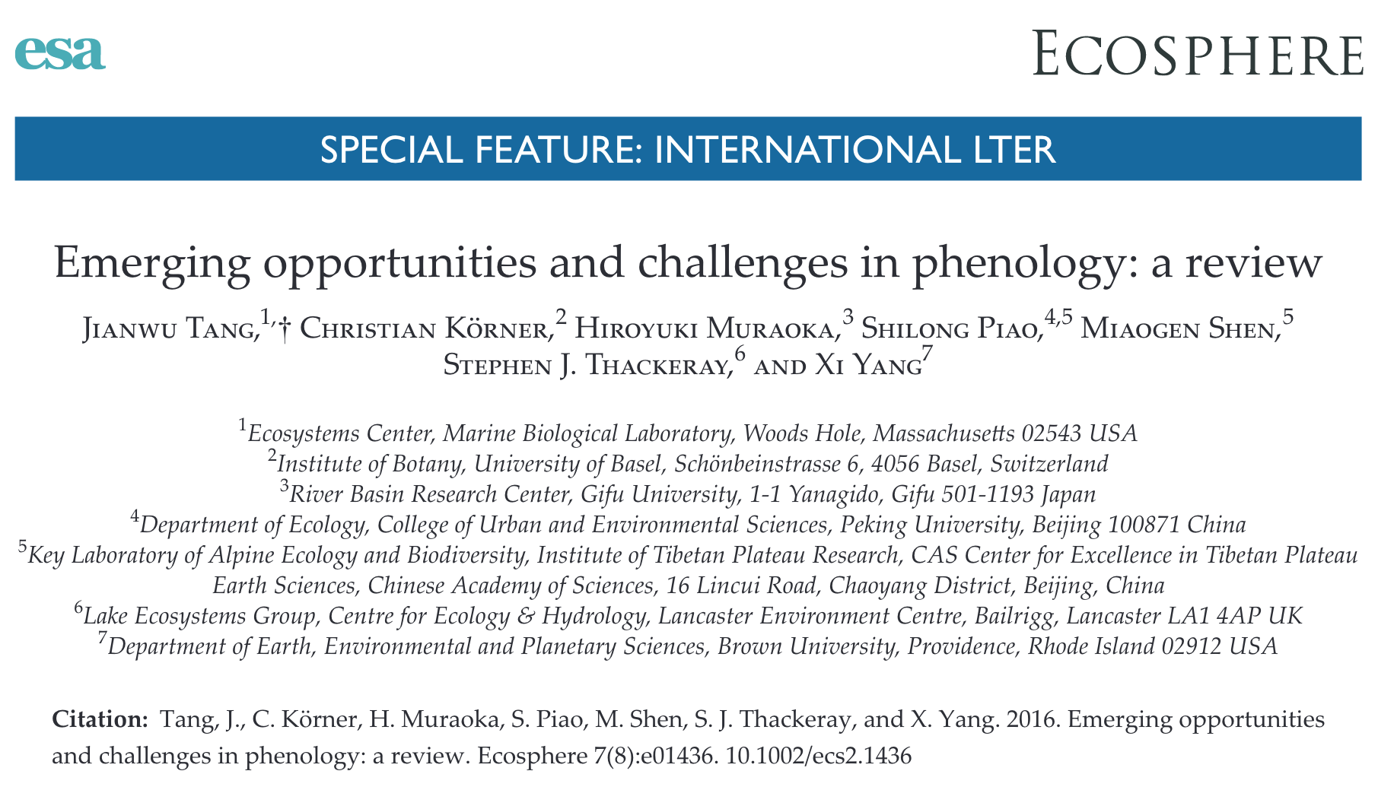
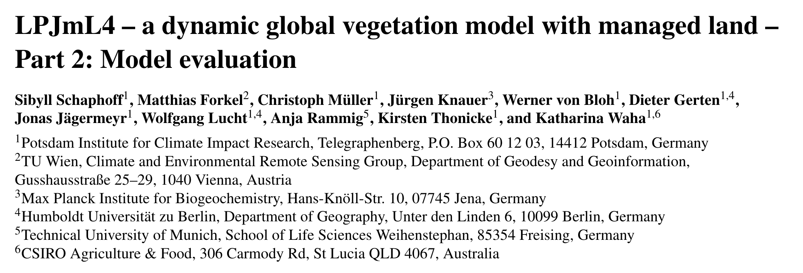
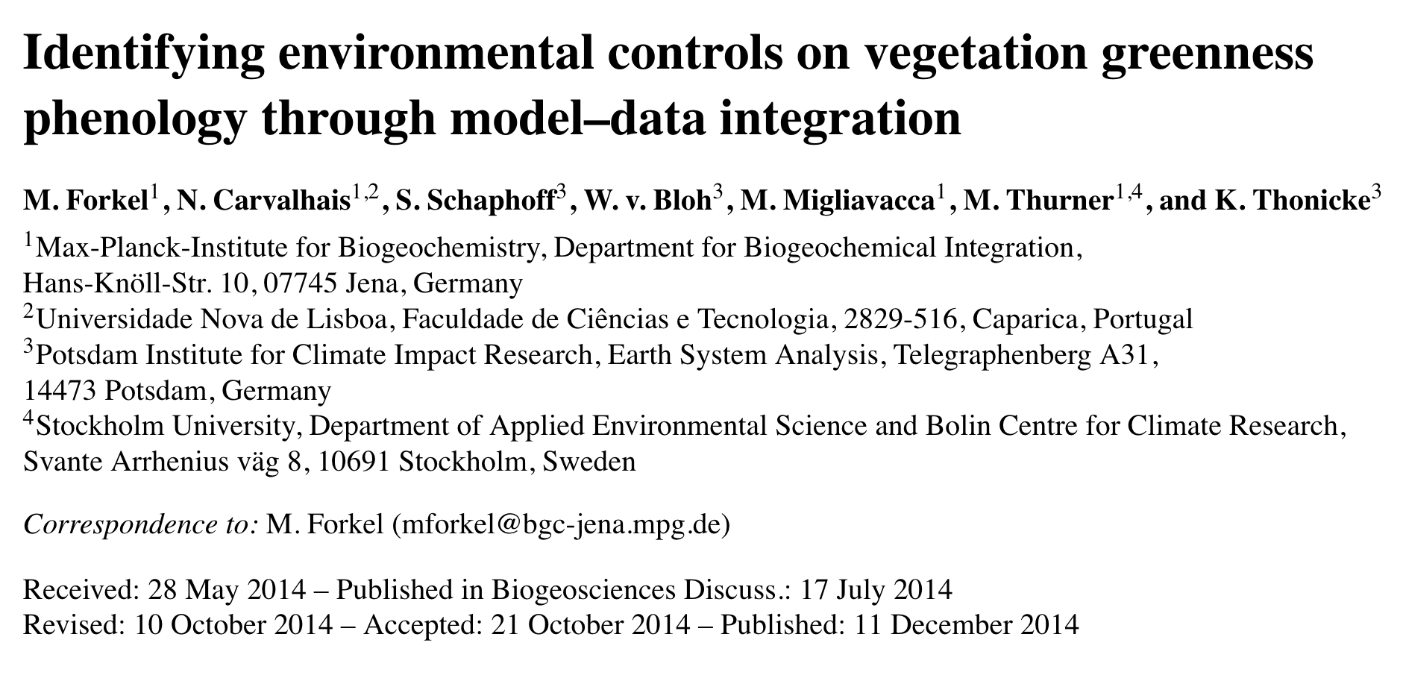
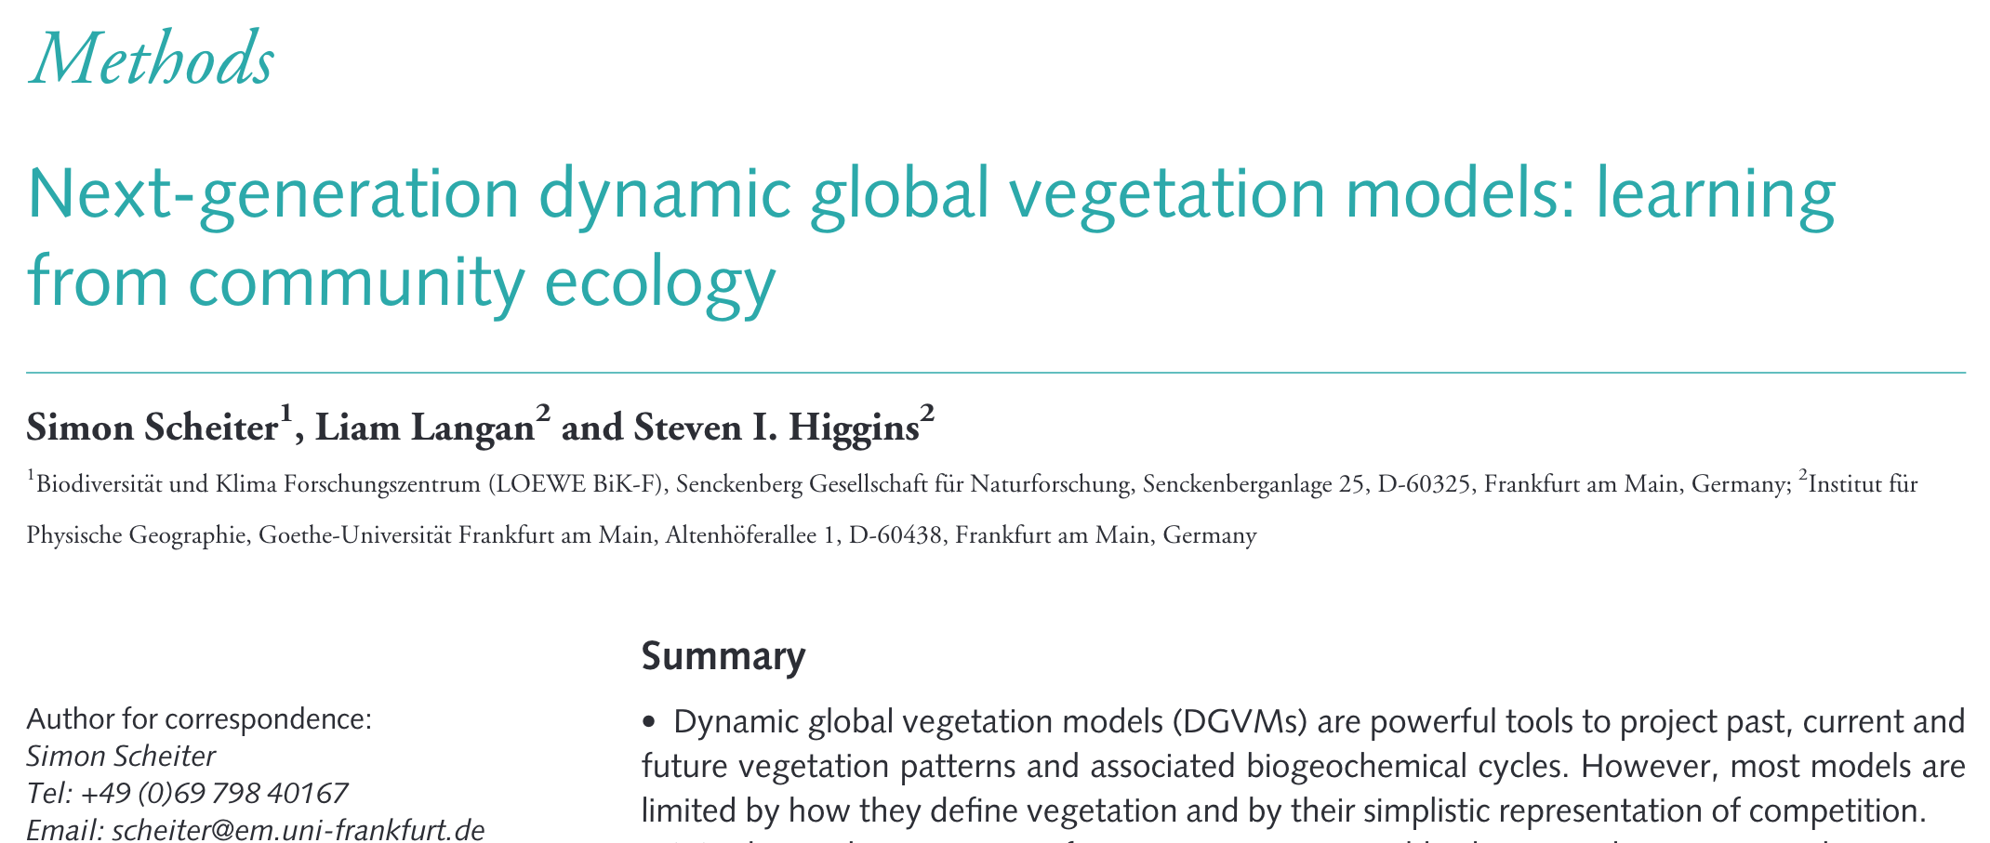
Coursework Example 1 Global Perspective
Me
Phn
Unc
Psyn
Mod
CC
Unc
40+ Citations

Slide 8
Coursework Example 2 Case Studies
Global energy balance defined
Links to the role of green house gases and anthropogenic changes
Problem class notes used to show the role of orbits and seasons
The global role of Terrestrial Vegetation defined
NPP and GPP defined using PEM examples
Complexities and biomes defined using DGVM as an example
Specific case studies then used to cover key aspects
One region where climate change has caused drier conditions and more wildfires - used to explain fire remote sensing techniques and feedbacks
A region of direct deforestation and the resultant effects on the TC cycle - also used to show the difficulty in observing forest carbon stocks using NDVI
A case study of crop land management and CH4 emission – how these are monitored and the global significance

Slide 9
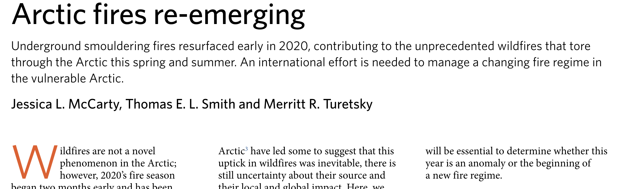
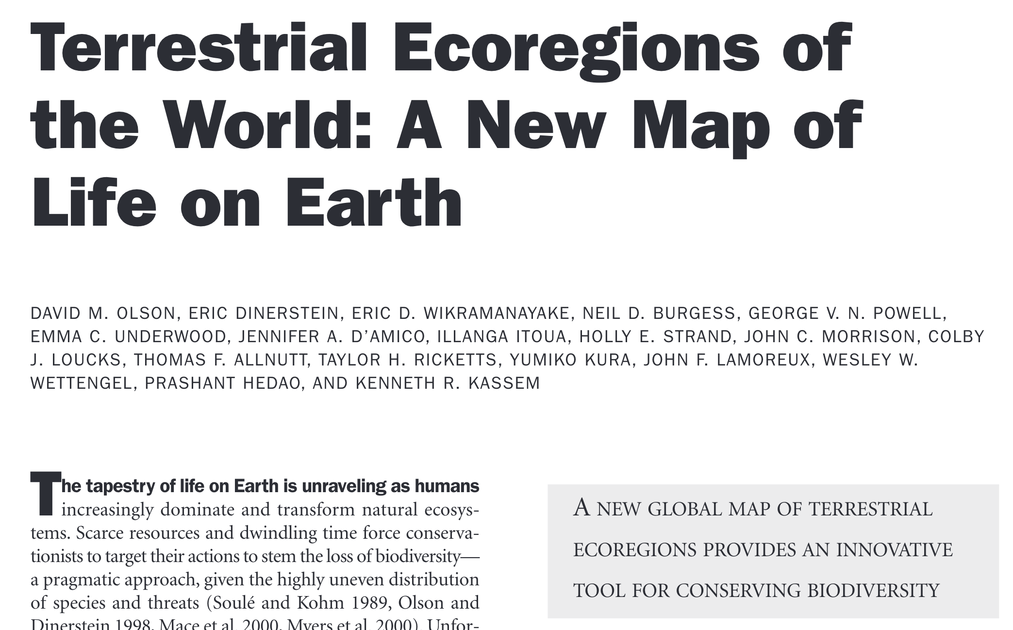
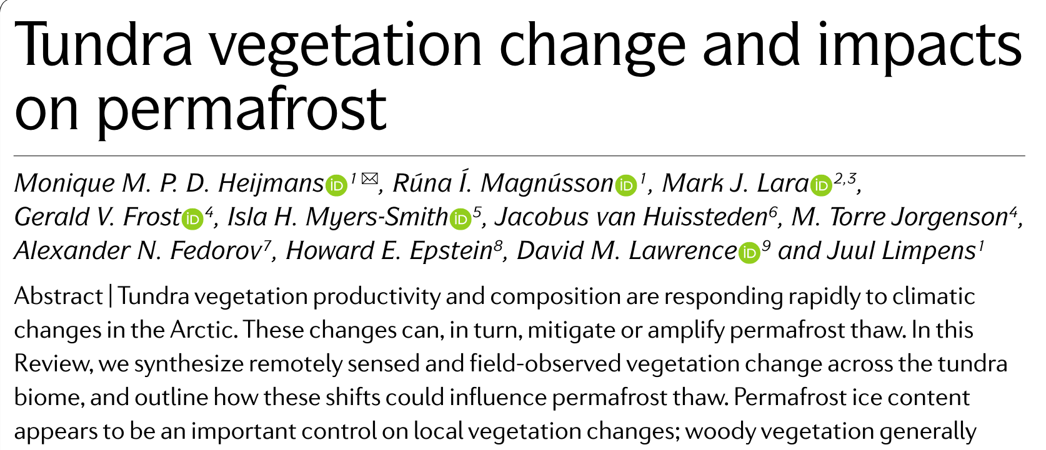
Coursework Example 2 Case Studies
CC
CC
Psyn
Me
Mod
Unc
Phn
40+ Citations

Slide 10

Coursework Example 3 Comparing observational scales
The essay focus is on comparing research methods, from in-situ observations to global models.
A table listing methods with some cited examples is included
Global NPP data sets are presented, and in order to explain what these data represent key definitions are included
The validation of these data sets is presented, including key information on uncertainty
Drivers of NPP are presented as a variability in global data
Definitions of what drives photosynthesis are included here with drought given as an example
Again observational in-situ comparison are presented alongside with method and length scale uncertainties included
Length scale comparisons are used throughout
Some good quality review articles are used to show this, along with some specific details of studies included within these reviews

Slide 11
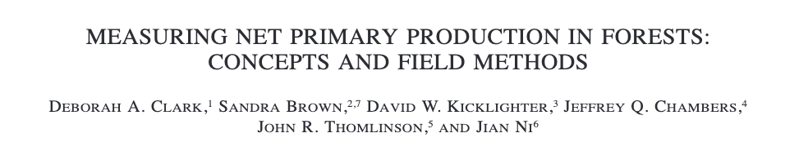

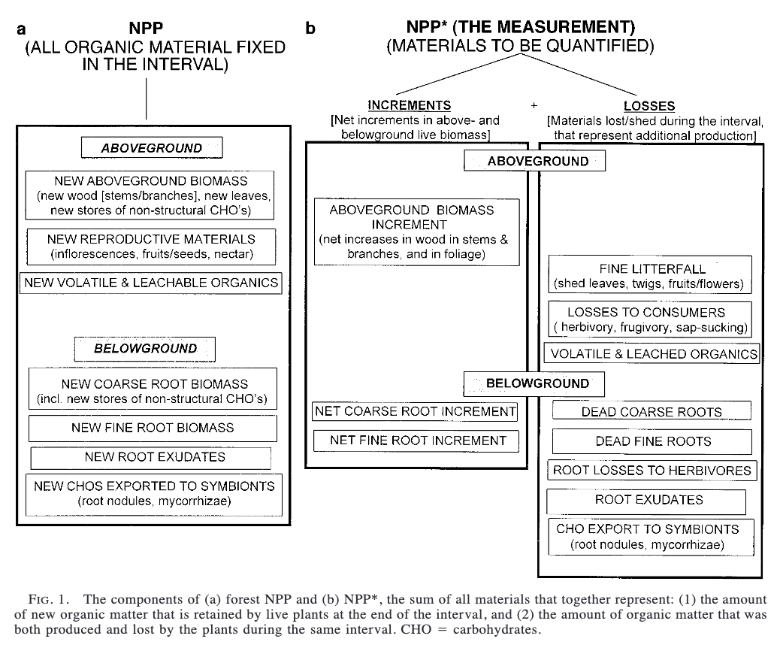
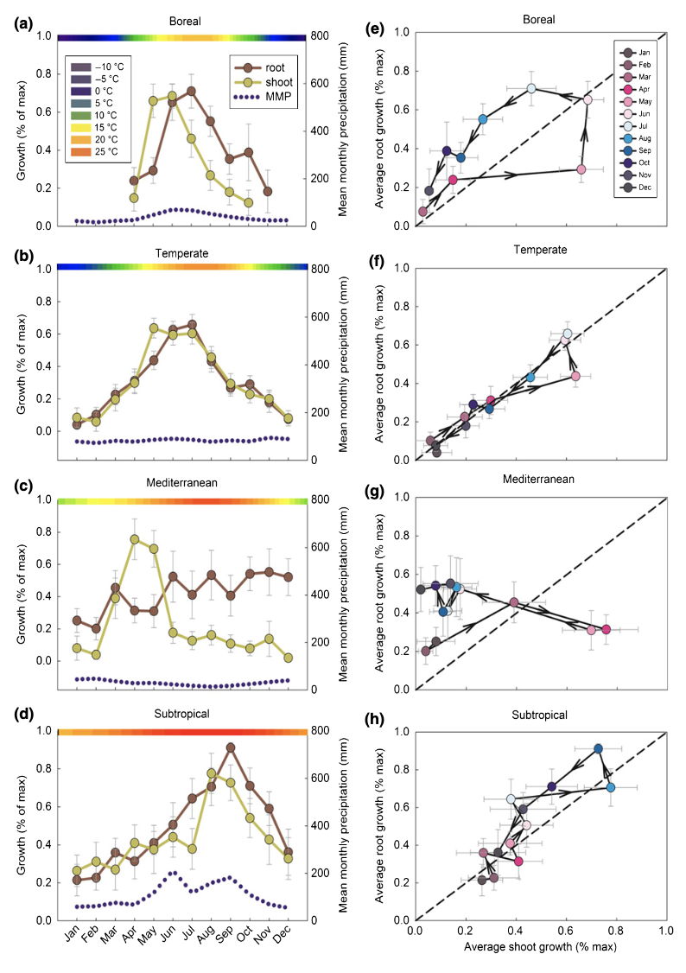
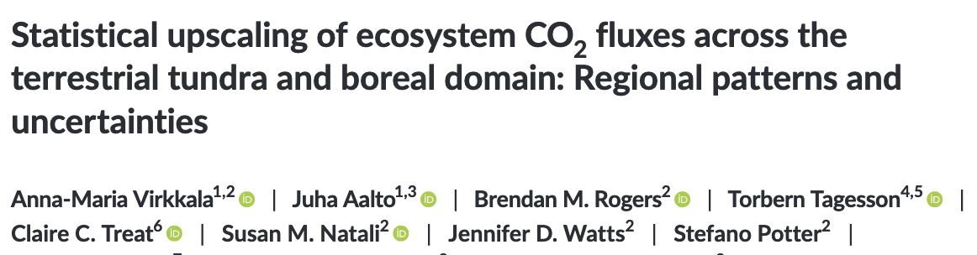
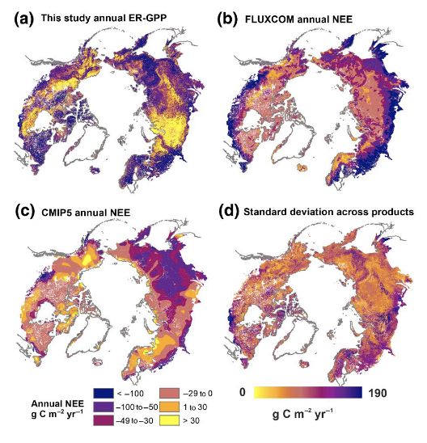
Coursework Example 3 Case Studies
CC
CC
Unc
Psyn
Me
Mod
Phn
50+ Citations

Slide 12
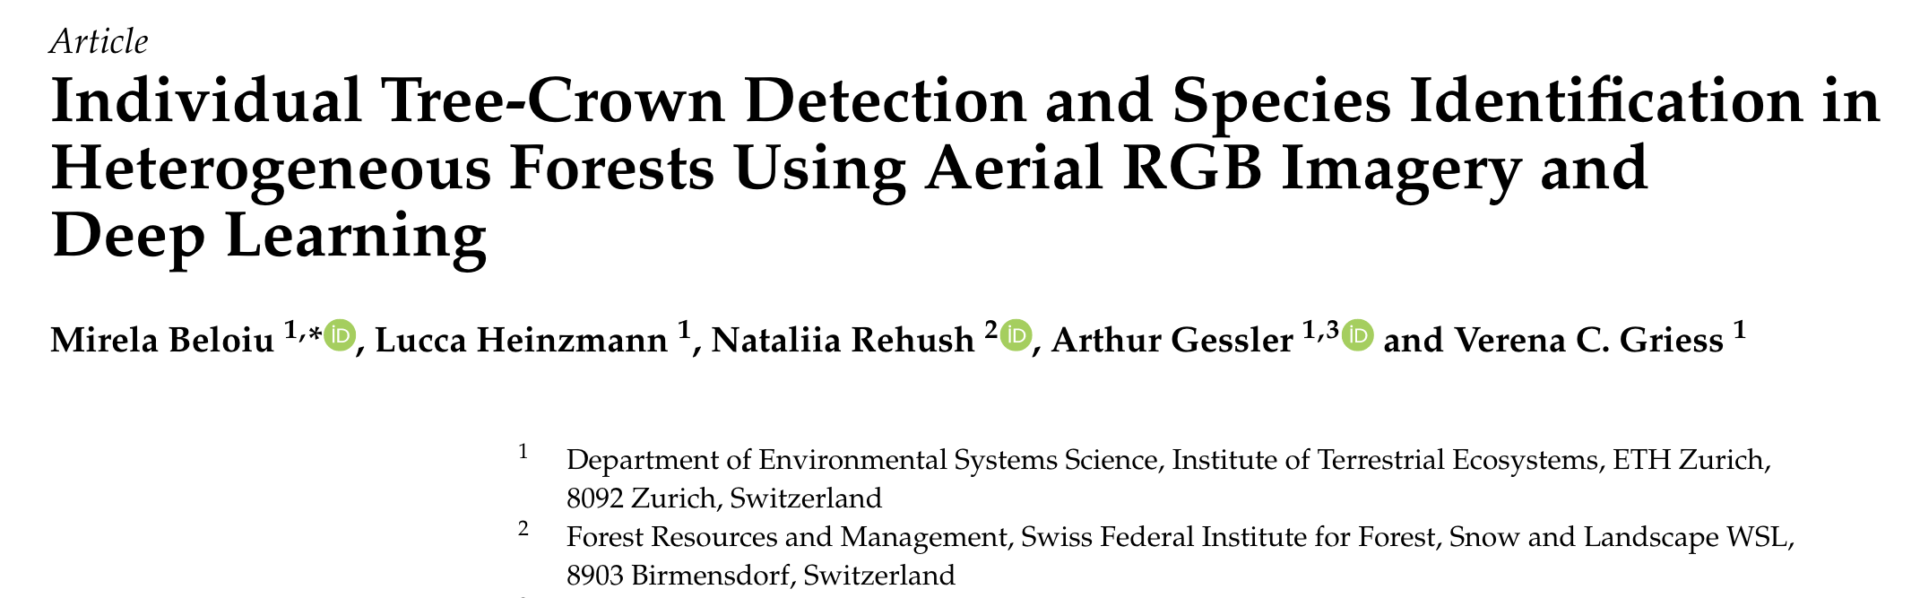
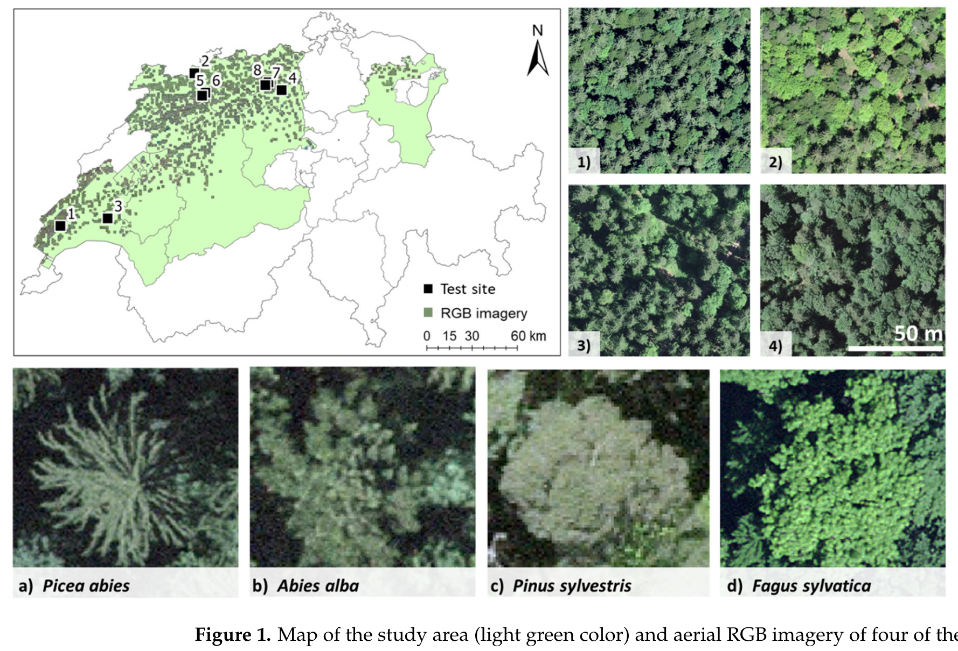
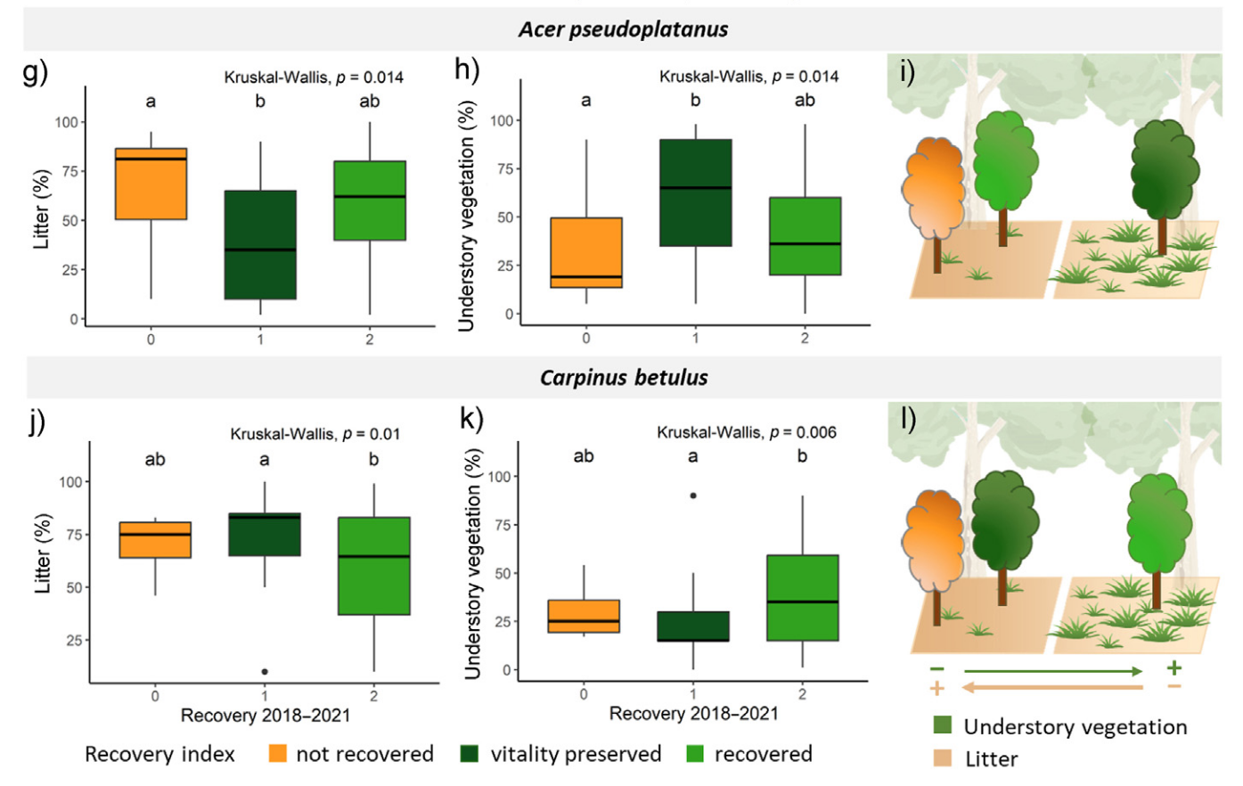
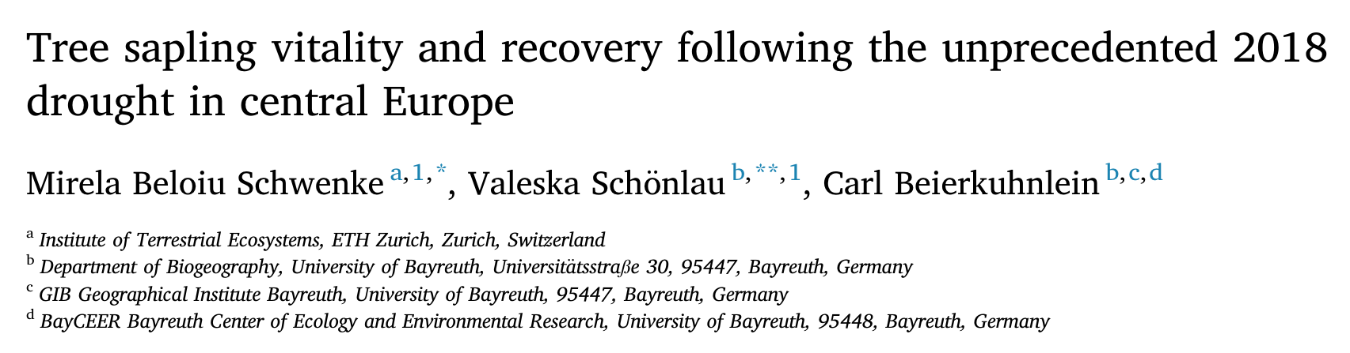
Coursework Idea Scaling up from a single study
By focusing on these studies, we can show the complexity within a forest canopy
A canopy is not homogeneous – lots of different plants of different species responding differently to forcing and disturbance
This leads into the design of a DGVM and the use of PFTs
Can the key PFT behaviours for this region be shown using the course notes? This will link these studies back to the question of NPP
But for all of this to make sense key concepts need to be explained:
Photosynthesis and response to temperature and PAR and thus NPP
Phenology as this is a broadleaf temperate forest
Climate change so to explain the drought disturbance
Now how does this small scale fit into the global picture?
What simplifications are made to represent this region in a PEM?
How does this simplification relate to uncertainty?
What other studies attempt to link this all together?
Quaife et al. (2008) data assimilation project does just this. And it only works because the key uncertainties are understood.
It is the knowledge of plant and biome level phenomena that inform the global picture
Me
CC
Mod
Psyn
CC
Phn
Unc
Mod

